Slide 1
DONE BY
Almasdivan.K(231008)
Ananda Dharshinee.M.S(231009)
Dheepika.R(231025)
Harini.K(231036)
Jayajanani.S(231041)
Keerthana.S(231050)
BLACK FRIDAY SALES PREDICTION

Slide 2

What is Black Friday?
Black Friday is the biggest retail sales day in the United States, often regarded as the unofficial start of the holiday shopping season. This season is crucial for the economy, especially for retailers. It traditionally marks the start of the Christmas shopping season in the United States.

Slide 3

PROBLEM STATEMENT:
A retail company wants to understand the customer purchase behaviour against various products of different categories. They have shared purchase summary of various customers for selected high volume products from last month. The data set also contains customer demographics product details and Total purchase amount from last month.
Now, they want to build a model to predict the purchase amount of customer against various products which will help them to create personalized offer for customers against different products.

Slide 4
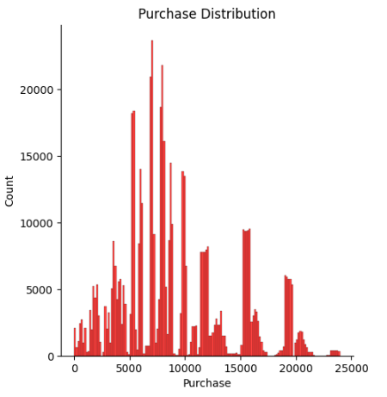
VISUALISATION

Slide 5
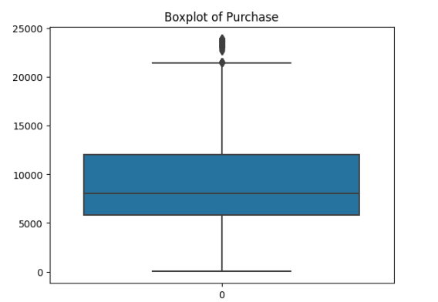
OUTLIERS

Slide 6
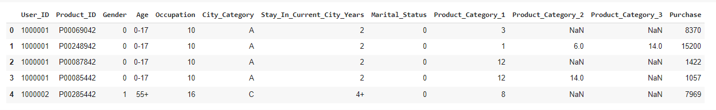
Transforming

Slide 7
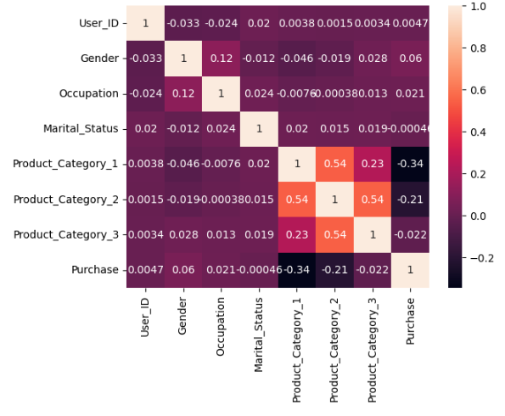
HEAT MAP

Slide 8
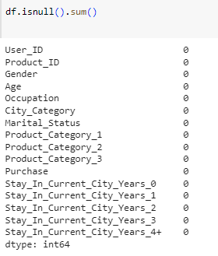
Predicting NULL Values

Slide 9
Spliting the Data Set

Slide 10

Linear Regression
Linear Regression is an algorithm that belongs to supervised Machine Learning. It tries to apply relations that will predict the outcome of an event based on the independent variable data points. The relation is usually a straight line that best fits the different data points as close as possible.

Slide 11

DECISION TREE REGRESSOR
Decision tree builds regression or classification models in the form of a tree structure. It breaks down a dataset into smaller and smaller subsets while at the same time an associated decision tree is incrementally developed. The final result is a tree with decision nodes and leaf nodes.

Slide 12

XGBOOST REGRESSOR
XGBoost, which stands for Extreme Gradient Boosting, is a scalable, distributed gradient-boosted decision tree (GBDT) machine learning library. It provides parallel tree boosting and is the leading machine learning library for regression, classification, and ranking problems.

Slide 13
LINK
GITHUB LINK:
https://github.com/Almasdivan/_Black_Friday_Sale_Prediction_Analysis-ML
https://github.com/ANANDADHARSHINEE/Black-Friday-Sales-Prediction
https://github.com/dheepika-r/Inlustro
https://github.com/Harinivaradhan
https://github.com/Jayajanani27/inlustro-blackfriday
https://github.com/KeerthanaS01/Inlustro

Slide 14
THANK YOU

